Slide 1

IMDb.com:
BI in Movie Review PlatformS
Text Mining and Sentiment Analysis on Movie Reviews
Dec.11 2018
Ruiting Zhan, Lufei Guan, Yijin Wang

Slide 2

Introduction
Project Background
Business Intelligence Questions
CONTENTS
Data Warehouse Design
Logical design
ETL and data quality control
Online Analytical Processing
Data visualizations on OLAP
Exploratory Data Analysis
“Cinema is the ultimate pervert art.
It doesn't give you what you desire - it tells you how to desire.”
― Slavoj Žižek
Data/Text Mining
Data mining
Text mining and Sentiment Analysis
Conclusion
Results and Conclusion
Future Development

Slide 3

INTRODUCTION
Project Background
Business Intelligence Questions

Slide 4
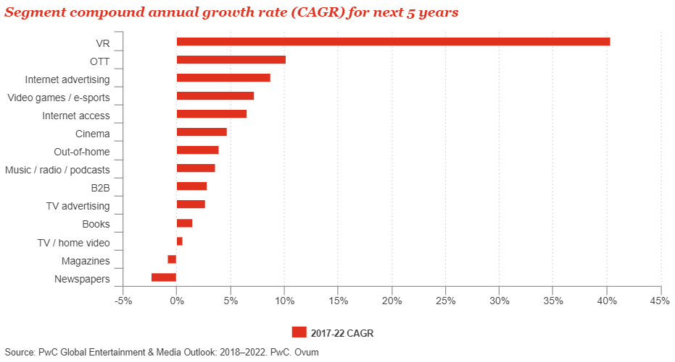
Project Background
Movie industry is profitable, especially in US movie market
Imponderable future of Movie Industry
Visual Reality technique is about to offer an innovation
Digital/online movie consumption is taking over traditional consumption mode in Movie Industry
Notes:
In 2015, the box-office revenue in total for movie industry is over 38 billion. And North America owns the largest market share.
From the figure, cinema is ranking in #6, but the top 5 are highly related to Movie Industry.
Digital and online movie consumption is constantly taking over the traditional consumption mode of movie industry.
When VR technology starts to popularize, the global movie industry will face another significant challenge.

Slide 5

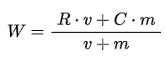
Internet Movie Database:
#1 movie and visual media database in the world
Fan-operated website from 1990, and become a subsidiary of Amazon.com since 1998
5.3 million movie and episode titles, 9.3 million of personalities, and about 83 million registered users (as of October 2018)
Users’ contribution on final score of a movie
Each of the ‘Regular Voter’ is given a weight (not disclosed)
Use Bayesian posterior mean to calculate weighted rating
Notes:
IMDb.com allows only active users to contribute to the ratings score of a movie. These eligible users are ‘Regular Voters’. Each of the ‘Regular Voter’ is given a weight when contribute to the final score of a movie, however, the criteria for a user to be a ‘Regular Voter’, and which user’s rating score is considered as a contributor are not disclosed, so that IMDb.com ensures a authoritative and reasonable score for every single movie, and at the same time avoids ballot stuffing as well.
Bayesian posterior mean: (considering both overall_score and num_votes)
W = weighted rating
R = average for the movie as a number from 1 to 10 (mean) = (Rating)
v = number of votes for the movie = (votes)
m = minimum votes required to be listed in the Top 250 (currently 25,000)
C = the mean vote across the whole report (currently 7.0)

Slide 6

Business Intelligence Questions
What are the most popular movies in recent three years?
For each type of genre, what are the top ranking movies?
How many movies were produced each year in different genres?
What is the average weighted rating for each genre in the recent three years?
Which movie genre is the most popular recently?
What aspect of a movie do users talk about most and pay most attention to?
What is the average score a user will give based on a positive/neutral/negative review?
Is there any associations among different genres?

Slide 7

DATA WAREHOUSE
DESIGN
Logical design
ETL and data quality control

Slide 8
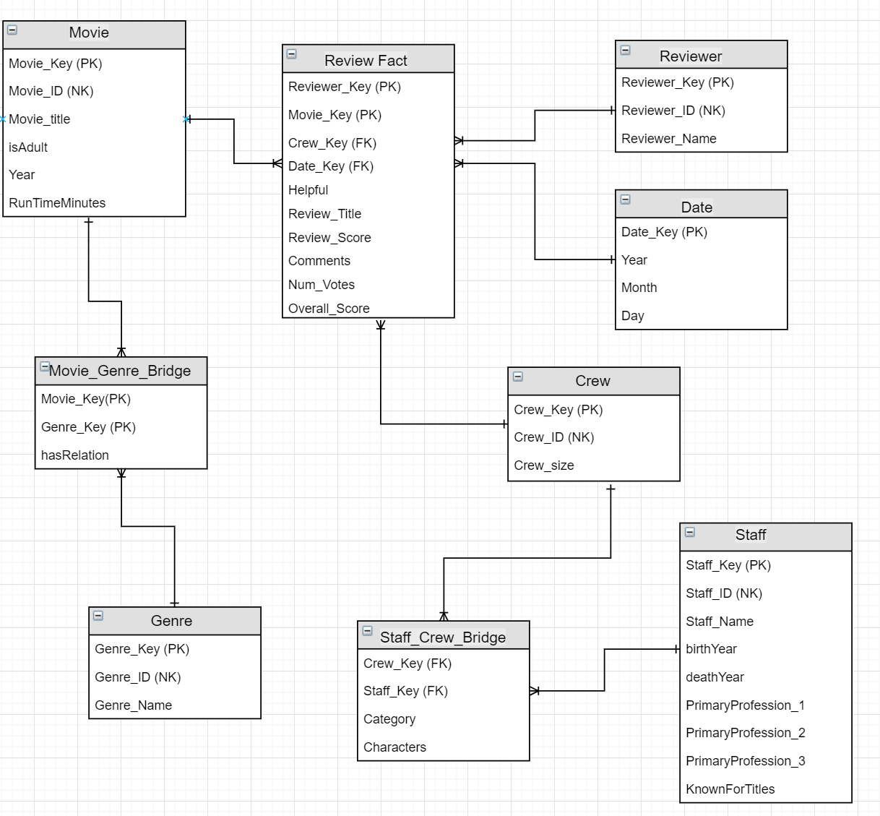
Star
Schema

Slide 9




ETL Process
Extraction
IMDb Public Dataset
Web Scraping - Movie reviews
Transformation
Splitting up fields (genres, professions)
Format changes (Date)
Deduplication
Loading
Dimensions - Create surrogate keys
Fact table - No null for foreign keys
Data Quality Control
Referential Integrity Constraints
Missing values
Anomaly Detection
Notes:
Our datasource are extracted from IMDb public dataset and web scraped data about movie reviews.
Referential Integrity Constraints: make sure all the foreign key are included in the primary key table. (It guarantees that every value in this column must match a value in the primary key of the department table.)

Slide 10

ONLINE ANALYTICAL PROCESSING
Data visualizations on OLAP
Exploratory Data Analysis

Slide 11










Top 10 Movies
Ranked by Weighted Rate
1 | The Mountain II | 8.92
2 | Avengers: Infinity War | 8.43
3 | Coco | 8.27
4 | Dangal | 8.22
5 | Bohemian Rhapsody | 8.18
6 | Your Name. | 8.14
7 | Three Billboards Outside Ebbing, Missouri | 8.11
8 | Logan | 8.05
9 | Hacksaw Ridge | 8.03
10 | Aynabaji | 8.01

Slide 12
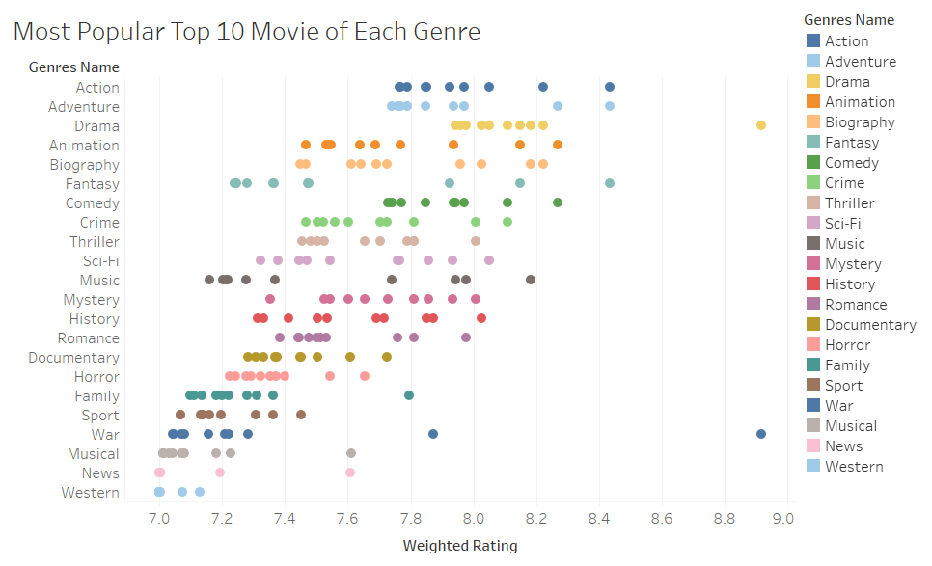

Slide 13
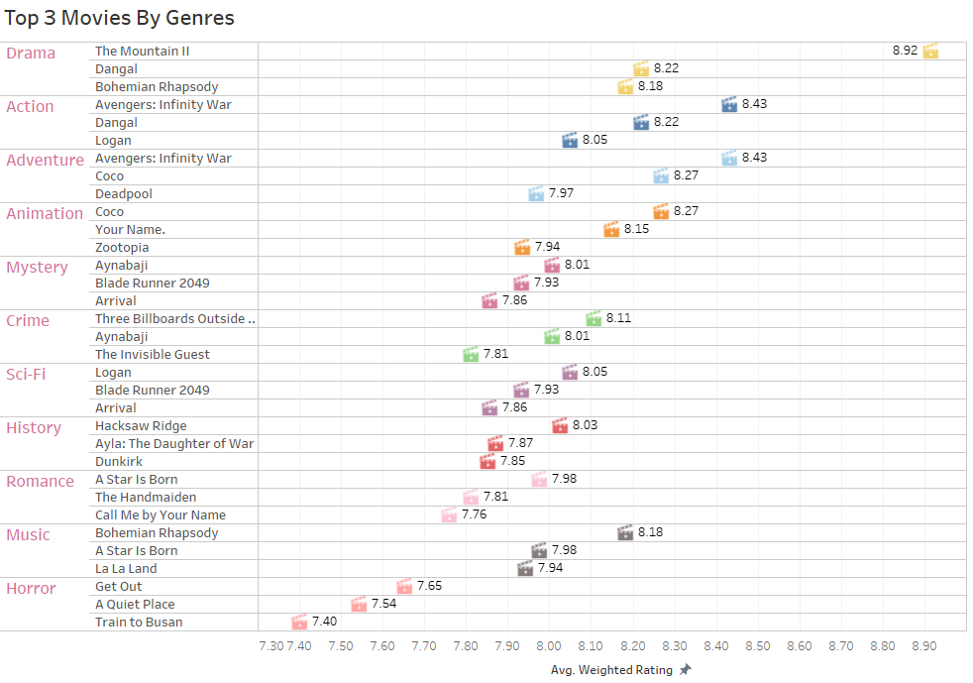

Slide 14
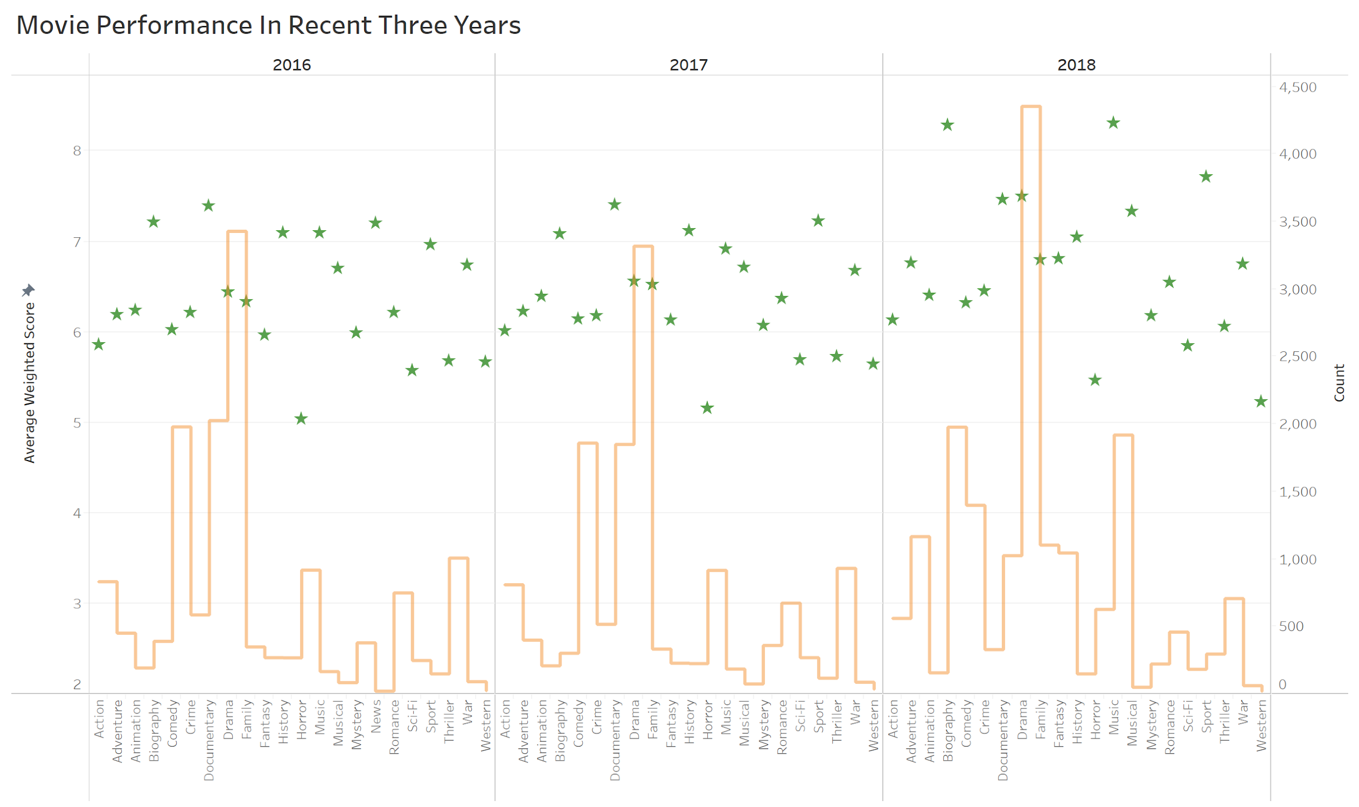

Slide 15

DATA/TEXT MINING
Data mining
Text mining and Sentiment Analysis

Slide 16
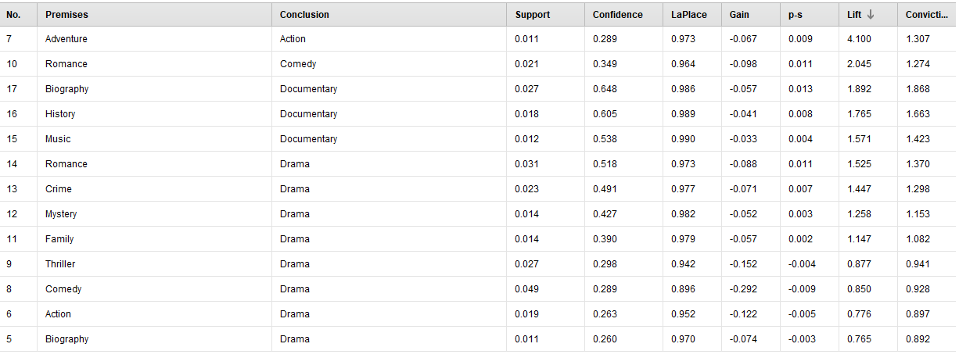
Association Rule Mining
min support = 0.05
min confidence = 0.2

Slide 17
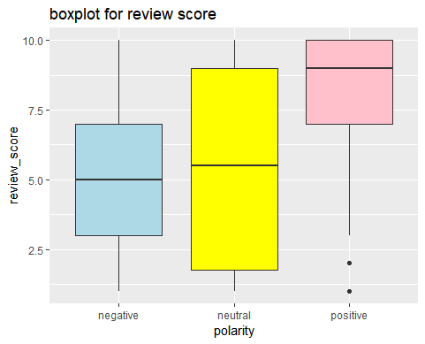
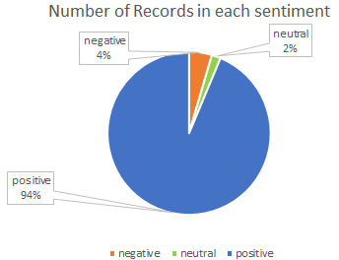
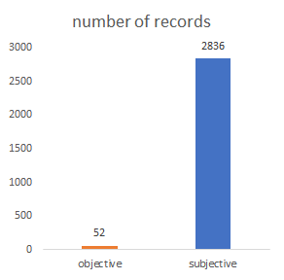
Text Mining
Sentiment Analysis for all reviews
Most positive
Most subjective
Positive: >= 9
Negative: <= 5

Slide 18
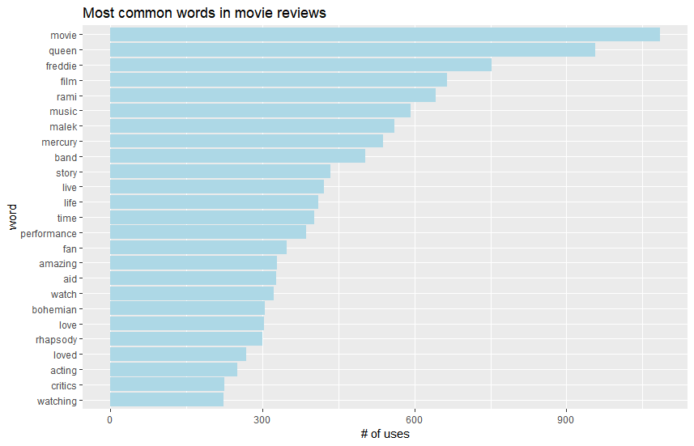
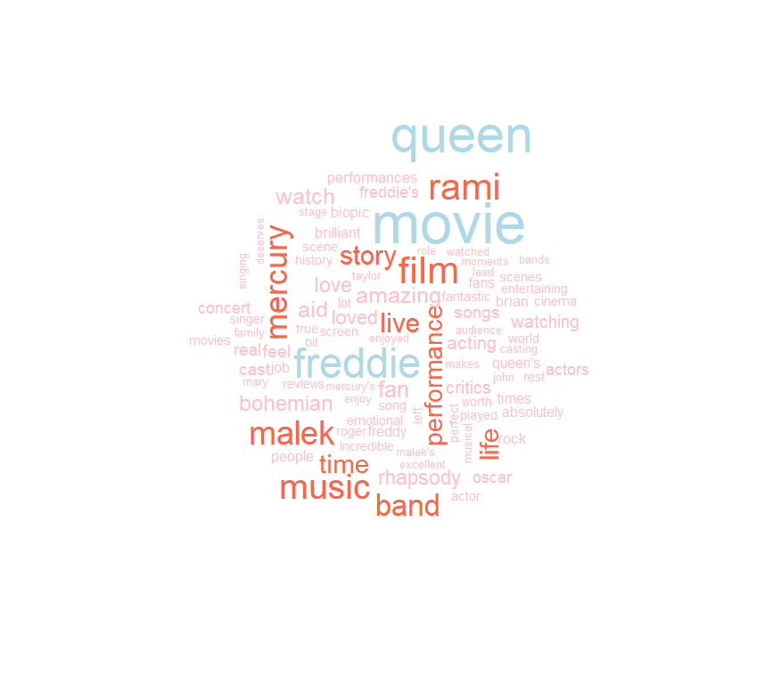
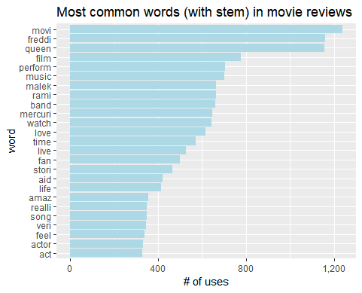
Keywords and Topic Extraction: movie ‘Bohemian Rhapsody’
Common words:
movie, film - background
music, band - topic
queen, freddie mercury, malek, life, story - content

Slide 19
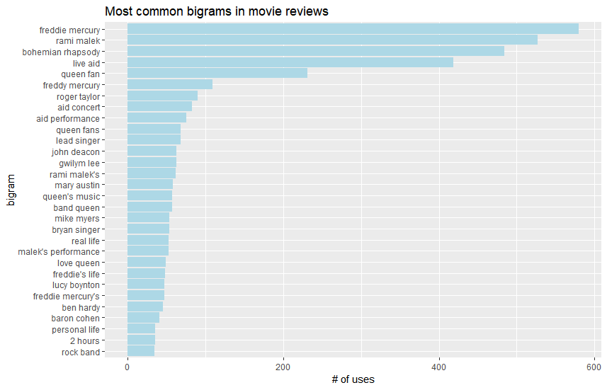
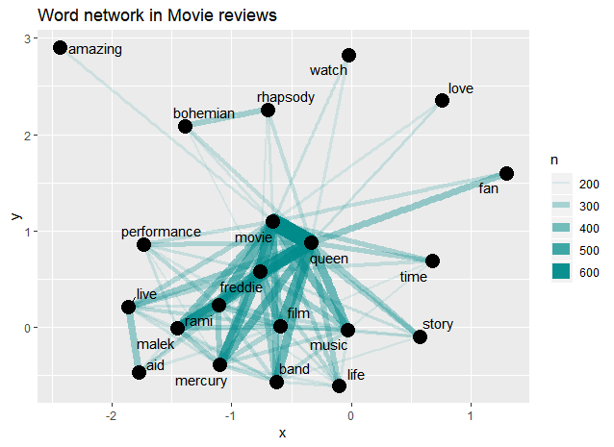
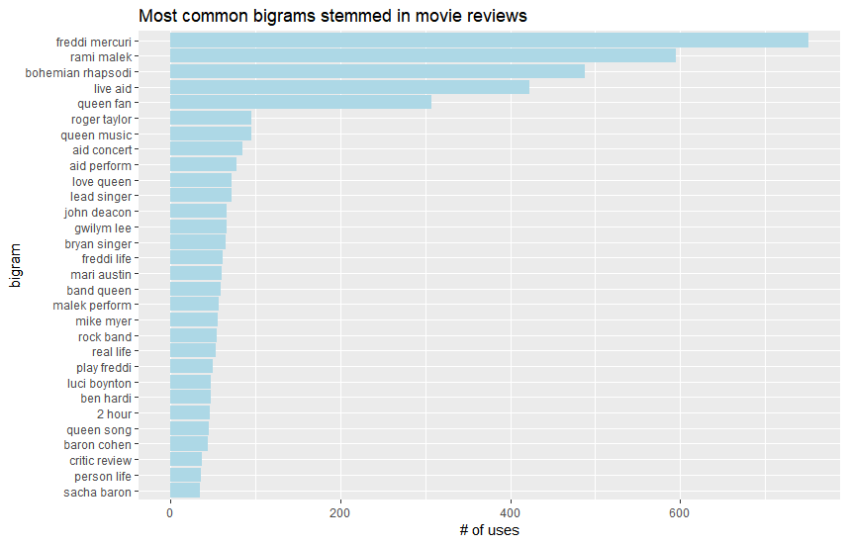
N-grams Analysis
Character name, Actor name, Movie name/song name, Concert name, Target: fan of the band, Music, biography, Band type: rock
Notes:
Character name, Actor name, Movie name/song name, Concert name, Target: fan of the band, Music, biography, Band type: rock

Slide 20
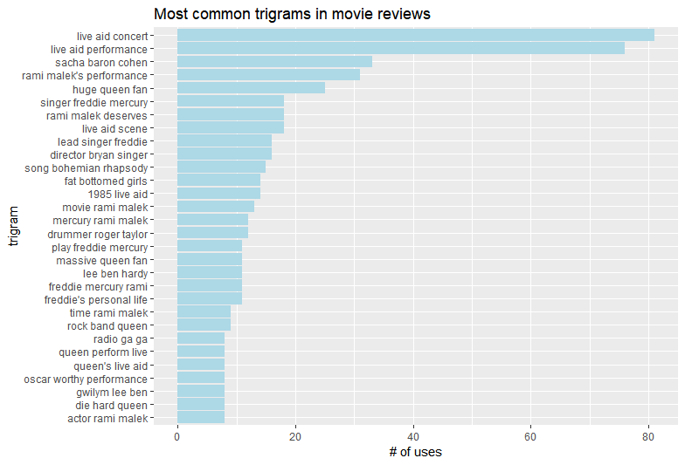
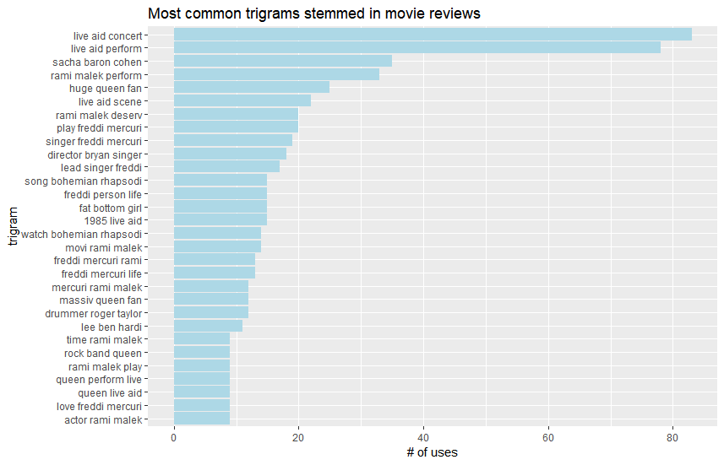
Role of each players in the band: eg. drummer
Concert: 1985 live aid
Movie: Oscar
This movie reviews are mainly focused on the content.
This is in general a good movie, no apparent negative words.
N-grams Analysis

Slide 21
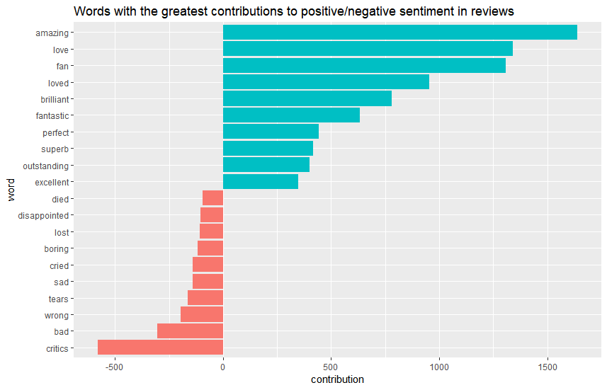
Word Sentiment

Slide 22
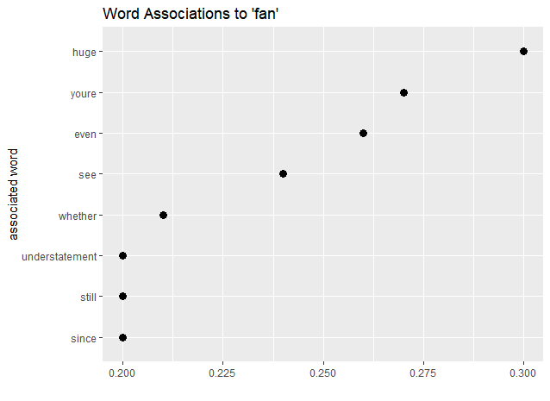
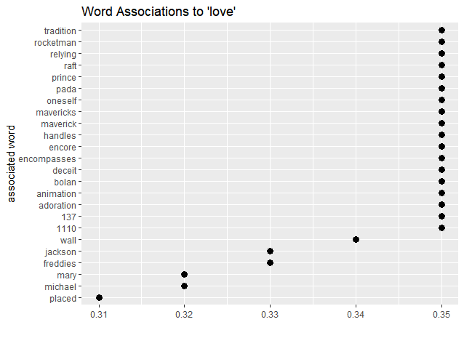
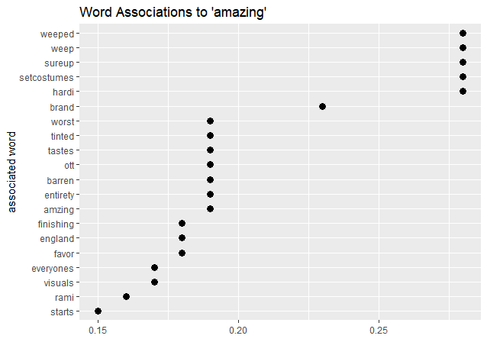
Word associations: for good movie (>=9)

Slide 23
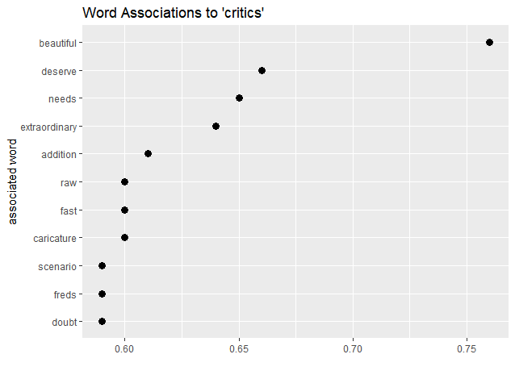
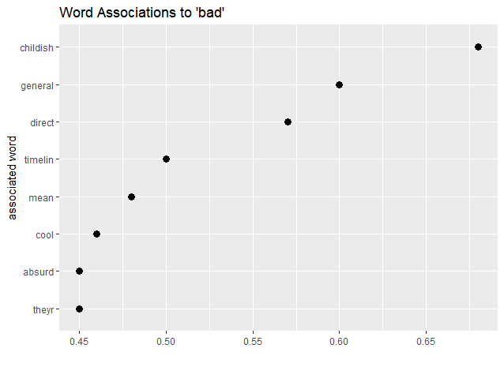
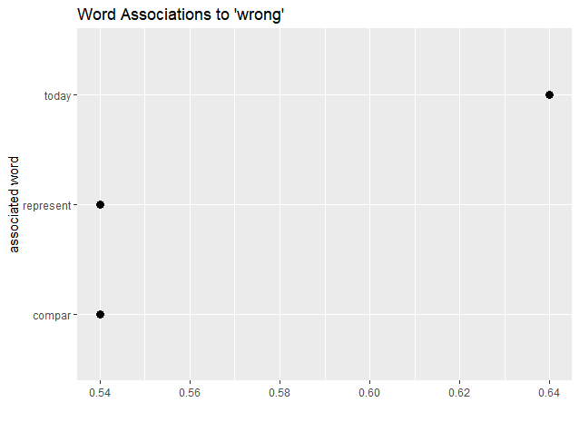
Word associations: for bad movie (<=5)

Slide 24
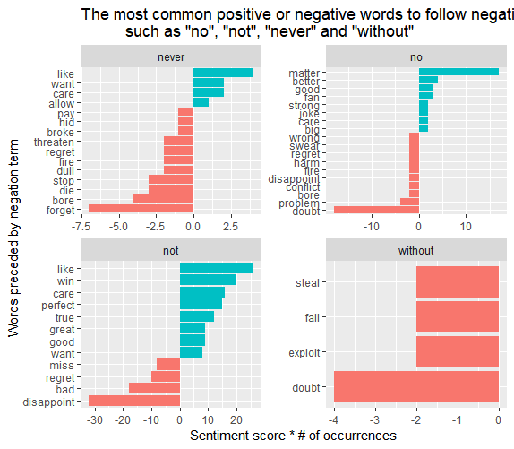
The most common positive or negative words to follow negations, such as “no”, “not”, “never”, and “without”
How negative words influence sentiment
Notes:
The most common positive or negative words to follow negations, such as “no”, “not”, “never”, and “without”

Slide 25
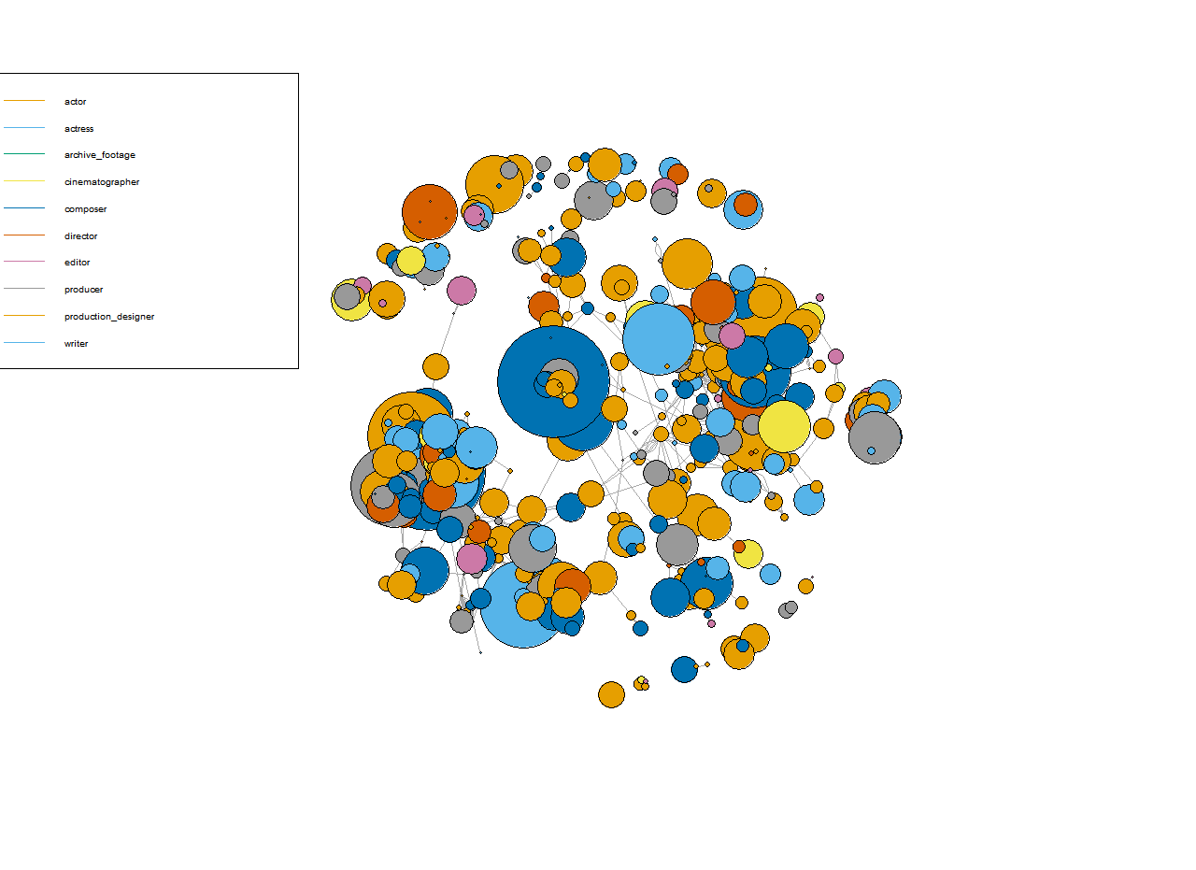
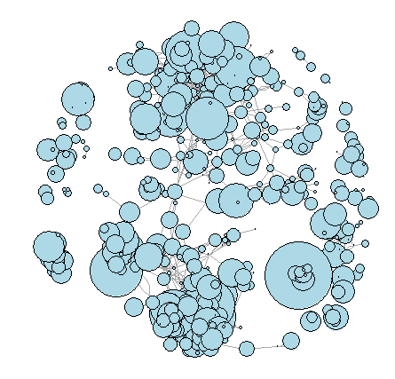
Social Network Analysis

Slide 26

CONCLUSION
Results and Conclusion
Future Development

Slide 27
Conclusion
Drama, Action, Adventure - Most Popular Genres
Increase in Biography, Music and Musical Genres with High Rating Scores
Adventure always comes with Action; Drama can apply to various genres.
Negative: score is high
Recommendation for IMDB:
Display keywords and topics
Reviews on several aspects
Recommendation for movie maker:
Future movie type
Find good story
Find good partner

Slide 28
Future Development
Data Diversity
Extract more movie related data from different movie review platforms
Extract more relative information: box-office, budget, etc.
Unsolved BI Questions:
Popular directors/actors
May require more information on personalities, but we focused on movie
Text mining:
Too many keywords that are related to scenarios
Think about getting rid of spoiler reviews or episode highly-related reviews
Applications:
movie review platforms like IMDb.com
TV series platforms, social media platforms, and also the most popular short-form mobile video apps, such as Tiktok and Douyin
Notes:
The model can help both users and platform operators to better understand about their videos, and to always be sensitive on the trend.

